Slide 1
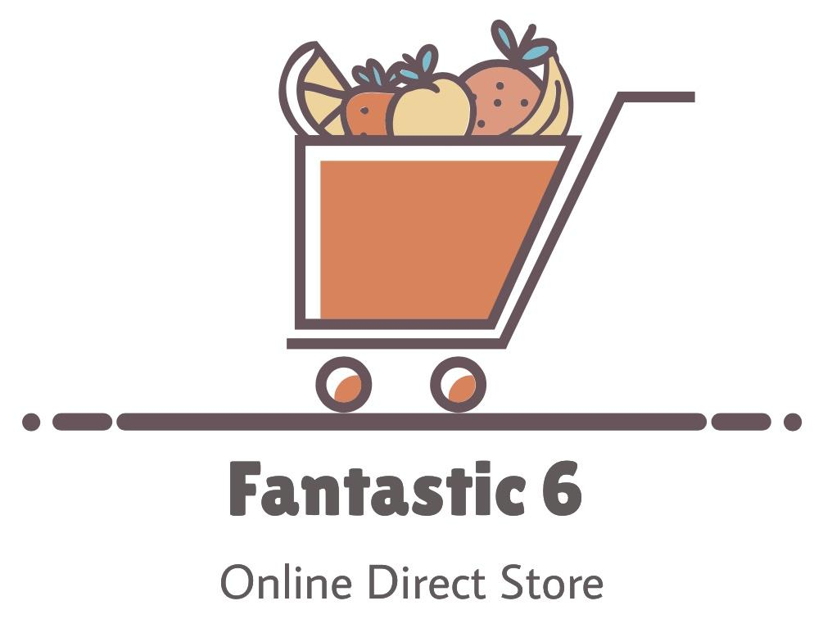
Team 4: Abram Flores, Anthony Hernandez, Vamshi Katipally, Fulya Kocaman, Wangmo Tenzing, Manthan Vasani

Slide 2
Outline
Introduction
Overall Description
Use Case 1
Use Case 2
System Features
Data Requirements
External Interface Requirements
Quality Attributes
Internationalization and Localization requirements
Other Requirements
Artifacts Review

Slide 3
Software Requirements Specification

Slide 4
Section 1 - Introduction

Slide 5
Project Scope
Firstly, what is our product?
Business Strategies
Expand reach, transparency, and communication
Expand overall catalog, increase income, by building foundation for 3rd-party vendors to sell directly on our platform
Business Objectives
Increase gross profit (BO-1), Increase customer lifetime value (BO-3)
Major Features
Various product filters shall be applicable, detailed product descriptions
Customer login and registration supported
Ability for customers to initiate and execute orders

Slide 6
Section 2 - Overall Description

Slide 7
Product Perspective
The Direct Store has no prior basis, apart from ABC’s physical stores
Product described in SRS will be the 1st increment of a 3-part release
Iteration 1: User Centric, encompasses most significant operations of the store
Iteration 2: Will allow vendors the ability to sell on the F6 Platform
Iteration 3: Mobile Application

Slide 8
Operating Environment
Product is intended to work well on the leading operating systems and hardware platforms
The anticipated location of the first users, servers, and databases of this software is NA (U.S.)
ABC expects the distribution of locations to expand overtime, reaching into foreign countries
Concentration of core users expected to remain the same

Slide 9
Design & Implementation Const.
CO-01: Time and Cost
CO-02: Development -> mainly JavaScript + JavaScript-compatible frameworks
CO-03: Data will be mostly transactional: use a relational DB, like MySQL.
CO-04: Login authentication will be handled through 3rd-party software (OAuth 2.0)
CO-05: State, National laws that relate to e-commerce; international laws

Slide 10
Assumptions & Dependencies
A-1: The majority of the product’s users will come from United States (I1-I3)
A-2: Users will acknowledge optimal medium for viewing (Desktop/laptop)
DEP-1: Items for catalogs and listings will be supplied by external platforms/vendors
DEP-2: Delivery of goods will rely on 3rd-party parcel delivery services

Slide 11
User Classes
Customer
CUS-02: Executes purchases by selecting from a variety of payment options
CUS-03: Browses & Filters through catalog
CUS-05: Creates login account for ease and convenience of shopping experience.
Developer
DEV-01: Modifies the layout/content of the platform in collaboration with Admin class
Dev-03: Regularly runs status checks and ensures server stability
DEV-04: Manage databases/integration

Slide 12
User Classes cont.
Vendor
VEN-01: Checks sales metrics and analytics
VEN-02: Requests items to be available for sale on ABC’s platform
VEN-03: Creates and maintains a public vendor account
Admin
AD-01: Directs the content and ads on the platform
AD-02: Approves and selects product requests from vendors

Slide 13
Use Case 1- UC-6 Place an Order

Slide 14
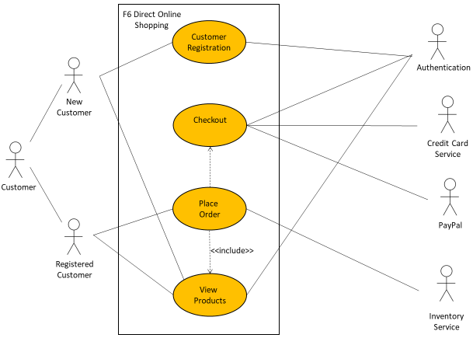
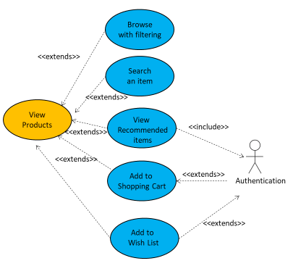
UC-6: Place an Order

Slide 15
UC-6: Place an Order Cont’d
Actors
Primary Actor: Customer
Secondary Actor: F6 Direct Online Store System
Trigger
A Customer indicates that they want to place an order
Description
A Customer accesses F6 Direct Online Store, checks out the shopping cart after viewing the items, adding them to the shopping cart, logging into the account or checking out as a guest, and placing the order to be picked up at the designated stores or delivered to their home or a specific location within a specified time window

Slide 16
UC-6: Place an Order Cont’d
Preconditions
PRE-1: Customer goes onto F6 Direct Online Store website
Postconditions
POST-1: Order is stored in F6 Direct Online Store System with a status of “Received”
POST-2: Order is sent to the shipping department or a third-party vendor
POST-3: Inventory of available products is updated according to this order
POST-4: Remaining delivery capacity for time windows is updated according to this order

Slide 17
UC-6: Place an Order Cont’d
Normal Flow- 6.0 Place an order
1. Customer views product by searching for an item, browsing a catalog with added filters, or viewing items recommended for them.
2. F6 Direct Online Store System displays available product descriptions and deals of the day.
3. Customer adds new products to the shopping cart or wish list from the available list of items.
4. F6 Direct Online Store System displays a message indicating the item added.
5. Customer proceeds to checkout when the order is complete.
6. Customer registers to the website for the first time by choosing a unique username and password (continue normal flow) or checks out as a guest (skip step 7).
7. Customer enters their login information.
8. F6 Direct Online Store System displays ordered items, individual prices, and total price, including taxes and delivery charges if any.
9. Customer either confirms the order (continue normal flow) or requests to modify the order (return to step 2).
10. F6 Direct Online Store System asks Customer to provide shipping and billing information.
11. Customer selects a delivery date and specifies the delivery location.
12. Customer specifies the payment method.
13. F6 Direct Online Store System confirms acceptance of the order.
14. F6 Direct Online Store System sends an email to Customer confirming order details, price, and delivery instructions.
15. F6 Direct Online Store System stores the order, sends order information to the Inventory System, and updates available delivery dates.

Slide 18
UC-6: Place an Order Cont’d
Alternative Flows
6.1 Use promotions, coupons, or gift cards
1. Customer asks to use an alternative payment method
2. Return to step 12 of normal flow.
6.2 User session times out
1. Customer places an order.
2. F6 Direct Online Store System informs the user that the session times out.
3. Return to step 6 of normal flow.
6.3 Repeat one of the past orders as the new order
1. Customer places one of the past orders they ordered before.
2. Return to step 5 of normal flow.
6.4 Order multiple identical products
1. Customer requests a certain number of identical products. (see 1.1.E1)
2. Return to step 5 of normal flow.
6.5 Order multiple products
1. Customer requests to order other products.
2. Return to step 1 of normal flow.
6.6 Delivery dates not ideal
1. Customer asks for pick-up instead of delivery at a designated store.
2. Return to step 12 of normal flow.

Slide 19
UC-6: Place an Order Cont’d
Exceptions
6.0.E1 Payment method rejected ending transaction
1. F6 Direct Online Store System rejects the Customer’s specific payment method.
2a. If Customer cancels the order, then F6 Direct Online Store System terminates this use case.
2b. Else if Customer requests to change the payment method, then return to step 12 of normal flow.
6.1.E1 Product out of stock
1. F6 Direct Online Store System displays Customer that the product from there is no longer available.
2a. If Customer cancels the order, then F6 Direct Online Store System terminates this use case.
2b. Else if Customer asks to put the product in backorder, then return to step 5 of normal flow.
2c. Else if Customer requests to change the product, then return to step 1 of normal flow.
6.2.E1 Unsuccessful login attempts
1. F6 Direct Online Store System displays Customer that they reach the maximum number of attempts during logging in.
2a. If Customer cancels the order, then F6 Direct Online Store System terminates this use case.
2b. Else if Customer changes the user name/password after getting redirected by the F6 Direct Online Store System, then return to step 7 of normal flow.

Slide 20
UC-6: Place an Order Cont’d
Priority
High
Frequency of Use
Approximately 1,000 users, an average of one usage per day
Other Information
1. Customer shall be able to cancel the ordering process at any time prior to confirming it.
2. Customer shall be able to view all purchases they ordered from the previous years and repeat one of those orders as the new order, provided that all items are available in the inventory.
3. After three consecutive unsuccessful login attempts, the user's account will be locked and must be reset by a system administrator.
4. Financing Department has access to all the credit/debit card companies and banks to confirm the e-payment given by customers.
5. Multiple customers from different locations shall be able to add items to the shopping cart simultaneously.
Assumptions
Assume that the user has an access to reliable internet and a device to get connected to the F6 Direct Online Store’s website.

Slide 21
Use Case 2 - UC-12 Admin Signin/Signup

Slide 22
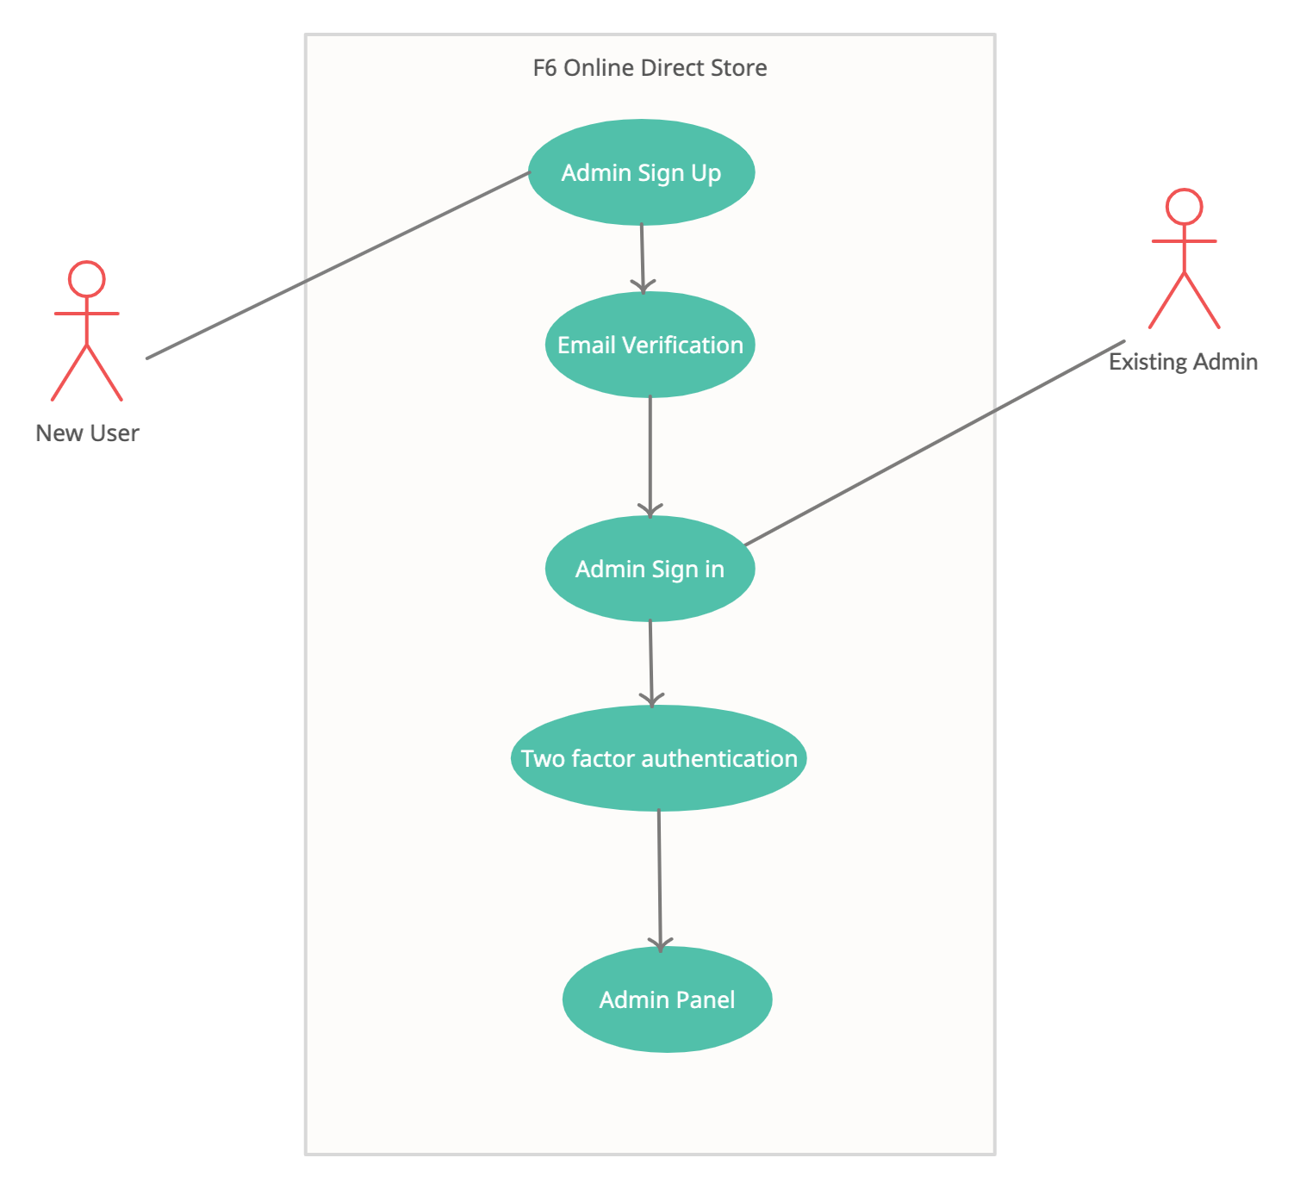
UC-12: Admin Signin/Signup Cont’d

Slide 23
UC-12: Admin Signin/Signup Cont’d
Actors
Primary Actor: Admin
Secondary Actor: Developer Team
Trigger
Admin clicks on the Sign in or Sign up button.
Description
Whenever an administrator wants to manage orders, accessing any confidential information, he/she needs to sign into his/her account. If the admin does not have any account he/she needs to create over there. To sign into the account, it requires credentials such as email address and password. For signup the admin has to fill up the form where he/she needs to enter some details like email address, phone no, password, date of birth, address, social security number etc.

Slide 24
UC-12: Admin Signin/Signup Cont’d
Preconditions
PRE-1: Admin clicks on Sign in or Sign up buttons.
PRE-2: Admins’ identity has been authenticated for sign in activity.
PRE-3: Admin entered all required information for sign up activity.
Postconditions
POST-1: Admin panel has been displayed after successful authentication.
POST-2: Admin log has been created and added into database with timing and ip address after successful authentication.
POST-3: User ip has been blocklisted after 3 unsuccessful login attempts. Data has been added into the database.
POST-4: Admin details with credentials have been stored into the database after successful signup.

Slide 25
UC-12: Admin Signin/Signup Cont’d
Normal Flow: Admin Signin/Signup
Admin click on sign in or sign up to access the admin dashboard.
Existing admin account holders enter email id and password to access the dashboard by passing two factor authentication.
Admin will be redirected to the two factor authentication page.
New admin clicks on the Sign up button.
Enters required details like first name, last name, email id, password, date of birth, address etc.
For new admin account creators, users need to verify email id within a specific time limit.

Slide 26
UC-12: Admin Signin/Signup Cont’d
Alternative Flows
Login session time-out
Existing admin enters login email and passwords and after the credential verification, admin is redirected to the two factor authentication page.
After the mentioned timeline, if the admin is not able to verify one time password, then the session times out.
Email verification link expires
New admin enters all required information into the sign up form.
Admin gets an verification email which contains an “verification link” to the mentioned email id.
Verification link expires within a specific time limit.
If it expires, return to the step 5 of normal flow.
If verification is successful, return to the step 2 of normal flow.

Slide 27
UC-12: Admin Signin/Signup Cont’d
Exceptions
12.0.E1 Unsuccessful login attempts
F6 Direct Online Store System displays admins that they reach the maximum number of attempts during logging in to the admin panel.
F6 Direct Online Store System blocks users ip address after reaching the maximum number of invalid login attempts.

Slide 28
UC-12: Admin Signin/Signup Cont’d
Priority
High
Frequency of Use
Approximately, 5 users, an average of 1 usage in a week.
Other Information
1. Admin shall be able to deny activation of two factor authentication.
2. After reaching maximum invalid login attempts, users’ ip will be blocked and can be unblocked by a database administrator or developer.
3. Admin should get an email after successful account creation.
4. Admin should get an email after every successful and unsuccessful login attempts with timing, location and ip address.
Assumptions
Assume that the user has access to reliable internet and a device to get connected to the F6 Direct Online Store’s website.

Slide 29
Section 3 -System Features

Slide 30
Search Bar
Stimulus/Response Sequence:
Clicking on the item results from the search bar will bring up the information related to that product.
Functional Requirements:
-System should be able to use the keywords user types in the search bar and display results that are valid and relevant to the search.
-System should filter results and display exact matches of the search bar at the top of the page.
-System should refresh the page if the search feature is frozen or crashes.

Slide 31
Update Inventory
Stimulus/Response Sequence:
-Once a certain product reaches a stock of 20, the management team will be notified.
Functional Requirements:
-System should allow backend developers to download user activity logs.
-System should allow developers to verify shipment/inventory invoices using a passcode.

Slide 32
Section 4 -Data Requirements

Slide 33
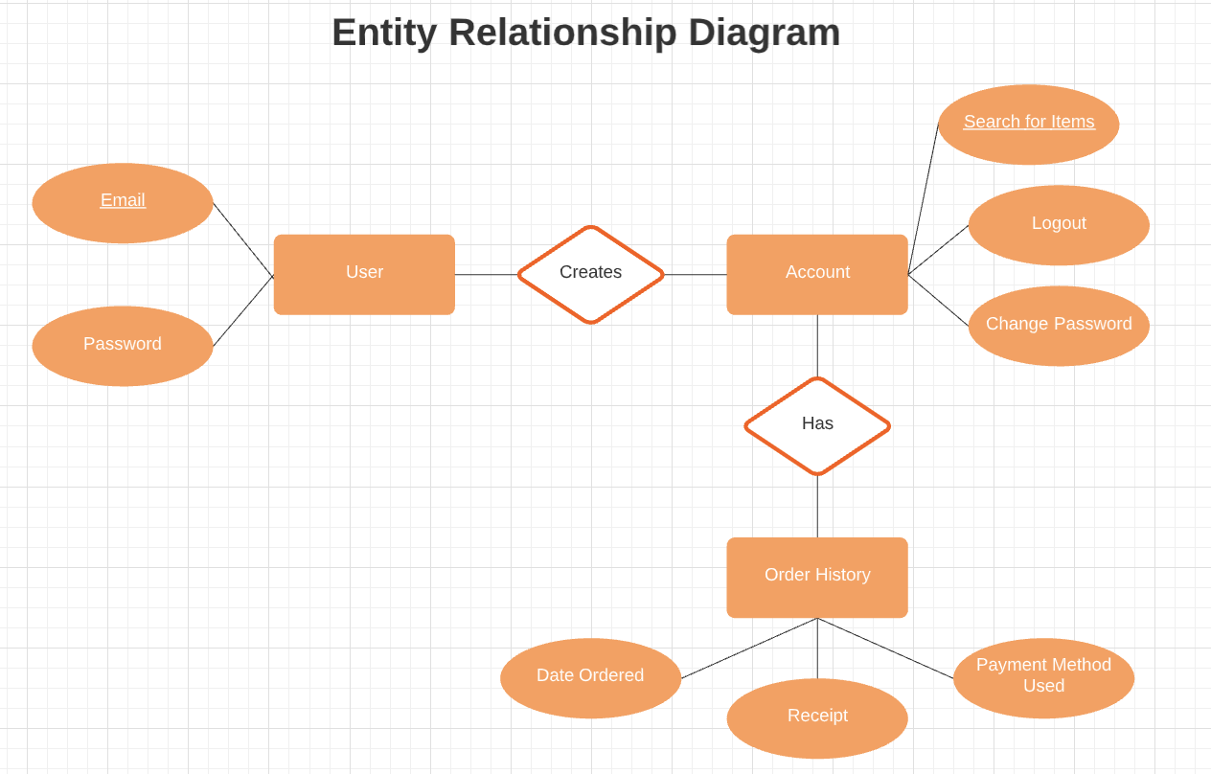

Slide 34
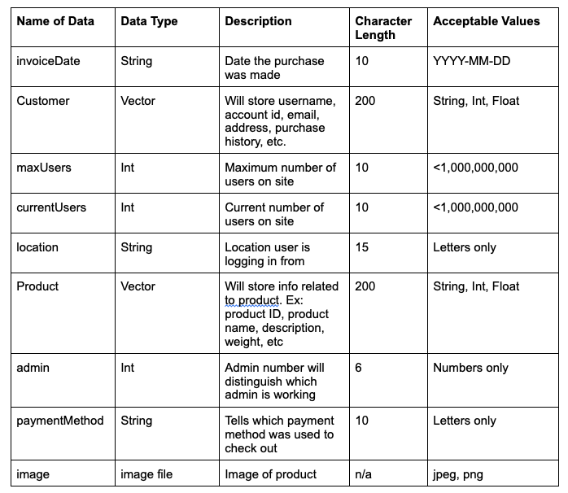
Data Dictionary

Slide 35
Reports Generated
User Activity Log:
More catered ads
Learning more about the user
Maintenance Log:
Track maintenance schedule
How long the site is down
When the site the down

Slide 36
Data Acquisition / Integrity
Data Storage: Persistence storage
Collecting new data
Legacy data
Sharing/exchanging data
Acquired data thoroughly reviewed to meet standards

Slide 37
Data Retention / Disposal
Data Storage Techniques: Backup, Mirroring
Metadata
Residual Data
Application Checkpointing: reverting back to a prior state

Slide 38
Section 5 - External Interface Requirements

Slide 39
User Interface
Priority on readability
Easy for online store newcomers
Recognizable

Slide 40
Software Interface
Interaction with product database
Updates from database regularly
Can update front end from back end

Slide 41
Hardware Interface
No need for specific hardware outside normal means to access the internet.

Slide 42
Communications Interface
Emails to users based on imputed email address
Provides an invoice with detailed purchase breakdown
Paypal plugin

Slide 43
Section 6 - Quality Attributes

Slide 44
Usability
-Customer service available to help
-Customer service number available everywhere in store page
–Tutorials on how to use the website provided

Slide 45
Performance
Process payments and send confirmation of purchase within 60 seconds of submission
No more than 4 days of downtime per year

Slide 46
Security
Secure off site servers to store personal data
Encrypted transactions
Trusted plugins like paypal
Restrict access to private information
User data not tracked or sold

Slide 47
Safety
No flashing imagery to trigger users with epilepsy
Secured user personal data

Slide 48
Section 7 - Internationalization and Localization requirements

Slide 49
Internationalization and Localization
F6 online store application will launch in Canada, United States of America and Mexico.
In order to be accessible for a wide range of users, F6 online store application will support American English & Spanish as the primary languages during the launch window..
F6 online store application will help partner with various local companies to train our system with the local dialects for users who use speech-text features on our website.

Slide 50
Internationalization and Localization (Contd.)
F6 online store application will bridge the gap between local businesses and customers by managing order delivery into remote areas of the country.
F6 online store application will have an option to contact a local liaison to improve communication between customers and company.

Slide 51
Section 8 - Other requirements

Slide 52
Other requirements
ABC Inc will apply for Business Operation License, Seller’s permit and Sales tax permits in order to incorporate F6 online store application as one of its offerings.
F6 online store application is built following the regulatory guidelines of international trading commission and local government rules.

Slide 53
Other requirements (Contd.)
F6 online store application will provide links to legal documents in the “About us” section where users can fact check ABC Inc’s offerings.
F6 online store application will support all devices that are capable of connecting to the internet and has a browser to render the website.

Slide 54
Artifacts Review

Slide 55
